Slide 1
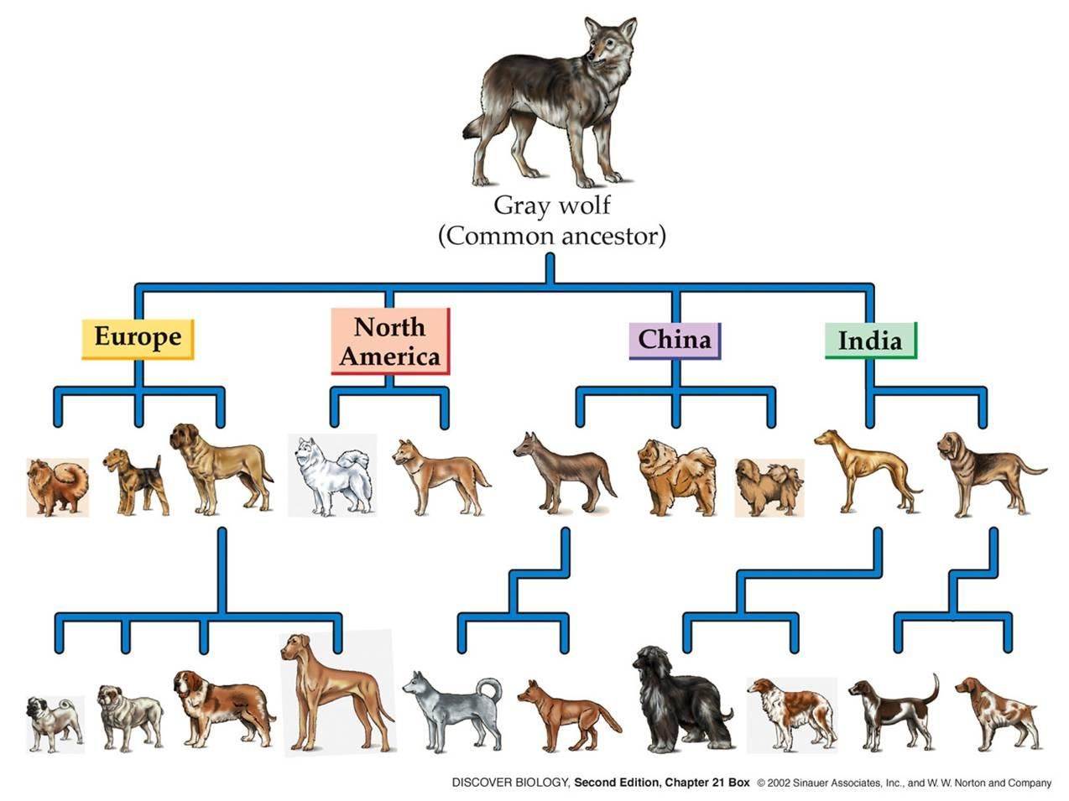
Do Now: Dec 5/14
How does artificial selection change living things over time?

Slide 2
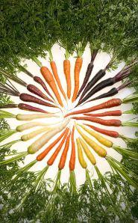
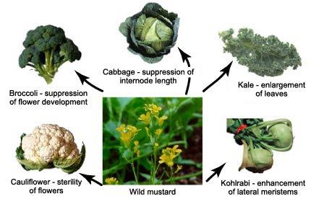
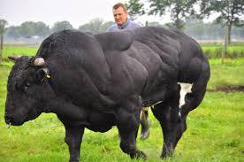
Can you think of other examples of artificial selection?
Artificial selection: The breeding of plants and animals to produce desirable traits.

Slide 3
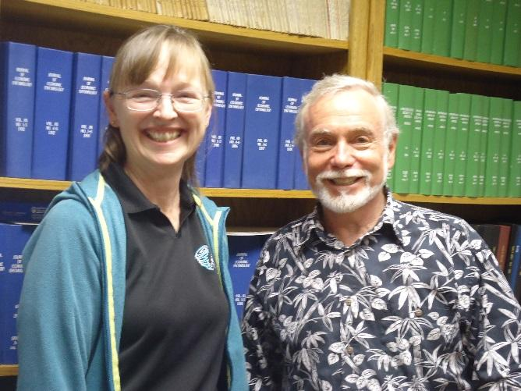
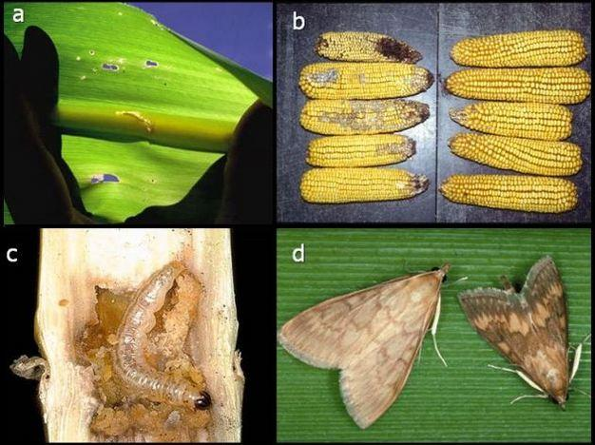
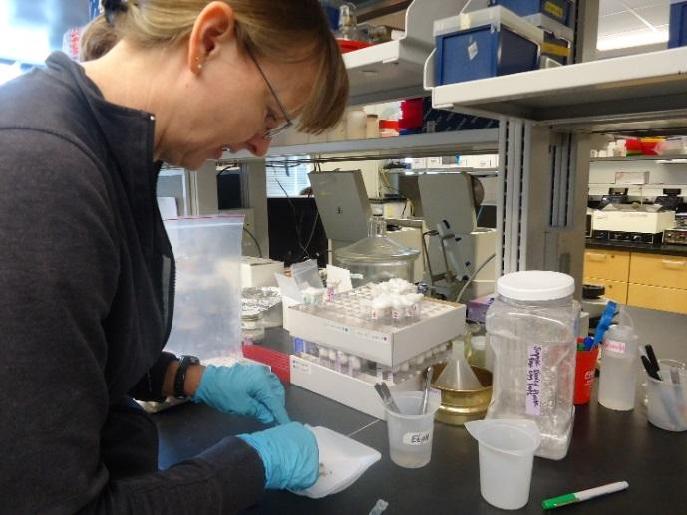
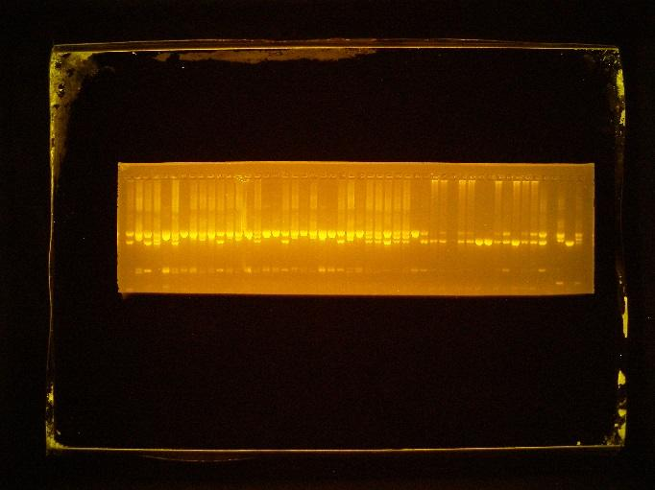
Kenan Fellowship
Genetic Engineering & Pest Control My work with Dr. Gould Go Wolf Pack!
Notes:
Image of European Corn Borer

Slide 4
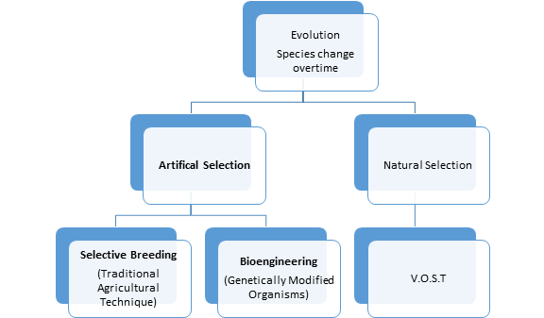

Slide 5
Essential Question:
How does artificial selection impact evolution?

Slide 6
Lab set up and group member roles:
Your group will need to choose a “sciency” name dealing with evolution.
Choose roles for each group member
Time Keeper
Spokesperson
Referee
Note Taker
Cheerleader
Write down on a note card the name of your group and the roles of each member of group.

Slide 7
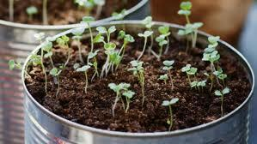
Fast Growing Seed Lab to simulate Selective Breeding
Today we will set up our fast growing seeds.
These seed will grow in 72 hours time. When we return on Monday we will be able to complete our lab.
1. Decide what seed each table will be responsible
for set up and carefully label the filter paper (use a pencil)
2. Do not add water until your group referee has
checked your filter setup.

Slide 8
Do Now: Dec 8, 2014
Take out a computer and headphones
Go to cyclonescience.com and the page called “What We Did in Class Today”
Follow the presentation on Evolution Today
By the end of the notes you should be able to answer the following questions:
What causes organisms to change over time (mechanism of evolution)?
How is biotechnology and selective breeding used to change crops?
Why do we use Punnett squares?

Slide 9
Do Now: 12/9/14
Take out your notes, “Evolution Today”.
Get a computer and complete the steps for “How to make a GM plant?” (10 minutes)
Make sure that every group member has notes on transgenic organism and the Punnett squares for our plant lab (second STOP and JOT)
Geology and Evolution Unit Test Dec 18, 2014

Slide 10
How does artificial selection impact living things over time?

Slide 11
Lab Discussion Today
Complete the Group Lab Sheet
Remember your group roles
Time Keeper - Make sure that each table in your group has an opportunity to share
Spokesperson- Reads each question during your review
Referee - Ensures every member is respected and heard
Note Taker- Ensures that the group lab sheet notes are accurate and reflect the groups
discussion
Cheerleader- Encourages and models good listen posture (eye contact, facing the
speaker)

Slide 12
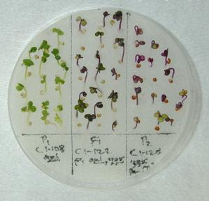
Data Collection for Lab Discussion:
Take out your Punnett squares in your “Evolution Today”
Note taker will make a table and record your results
Plate # | Seed Type and/or Crosses | Outcome (What do the seeds look like?)

Slide 13
Data Analysis: What were the results?
As a group discuss the following questions:
How well did your Punnett square predict the outcome of your seed crosses?
Did any errors occur that could have impacted/skewed your results?

Slide 14
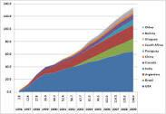
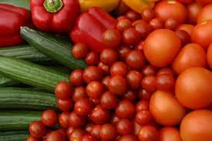
Do Now Dec 10, 2014
How can GM crops impact the way living things look over time?
Genetically modified crops (GMCs, GM crops, or biotech crops) are plants used in agriculture, the DNA of which has been modified using genetic engineering techniques.
Notes:
Definition and graph is from http://en.wikipedia.org/wiki/Genetically_modified_crops

Slide 15

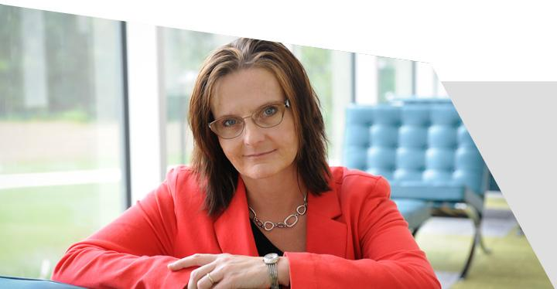
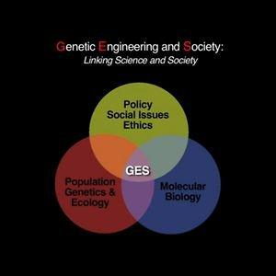
Dr. Kuzma
Social Scientist

Slide 16
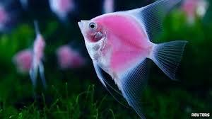
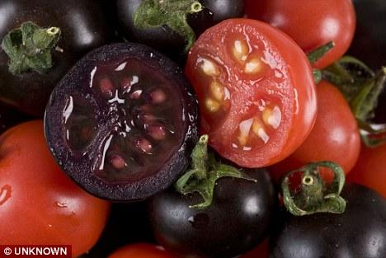
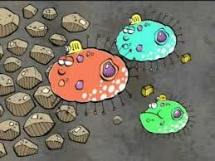
How can biotechnology impact our society and environment?
Today you will “speed” review 3 new biotechnologies:
GM Crops (covered during class)
Genetically Modified Pets
De-Extinction
Biomining

Slide 17
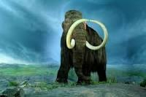
How will we review “The Evolution Today” topics?
Topic #1 - Biomining
Topic #2 - De-Extinction
Topic #3 - Genetically Modified Pets
Go to cyclonescience.com and the page called “What We Did in Class Today”

Slide 18
Do Now: 12/11/14
Continue the review on “Evolution Today” topics?
Topic #1 - Biomining
Topic #2 - De-Extinction
Topic #3 - Genetically Modified Pets
Go to cyclonescience.com and the page called “What We Did in Class Today”
Geology Unit Test Dec 18, 2014

Slide 19
Do Now: 12/12/14
Continue the review on “Evolution Today” topics?
Topic #1 - Biomining
Topic #2 - De-Extinction
Topic #3 - Genetically Modified Pets
Choose a topic that your group will focus on and set up your group graphic organizer
Geology Unit Test Dec 18, 2014

Slide 20
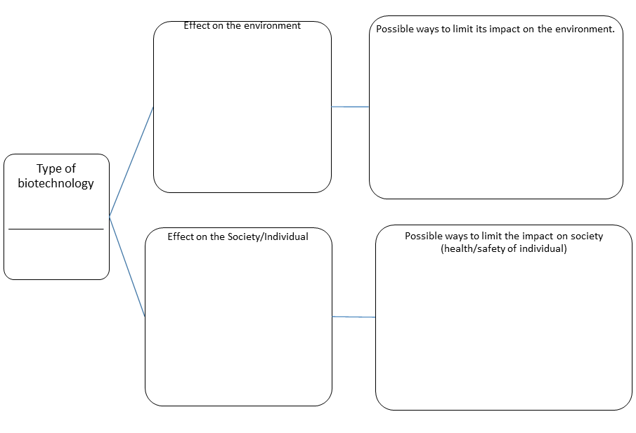
Group Graphic to Analyze the Ethical Use of New Biotechnology.
How can biotechnology impact our society and environment?
What are some possible ways that we should regulate/control this new technology?

Slide 21
Materials to Support the Lesson

Slide 22
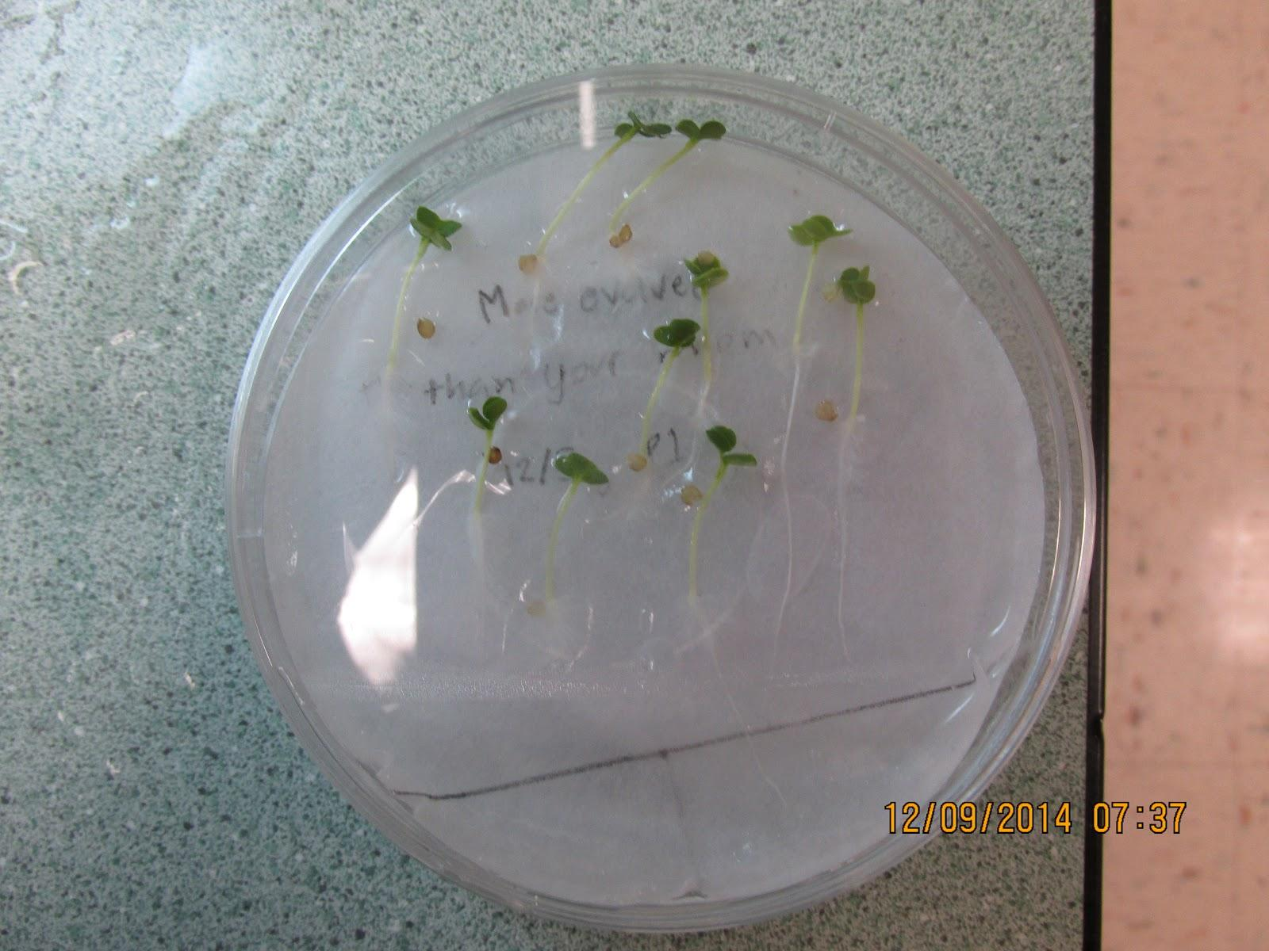
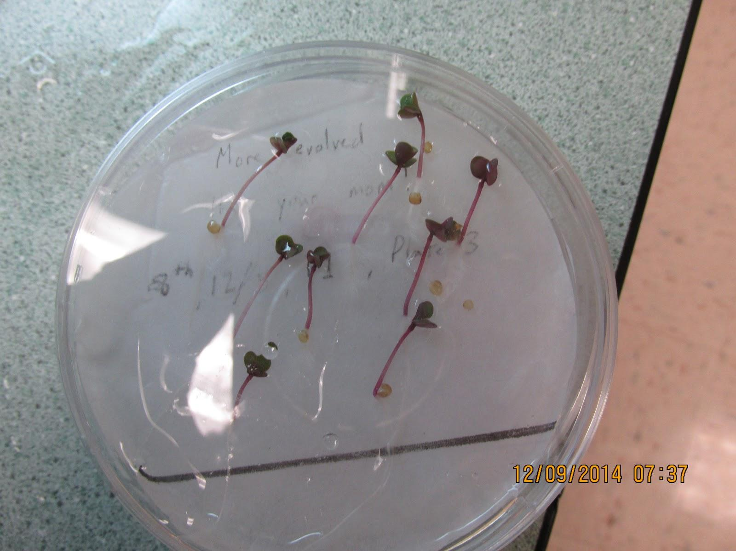
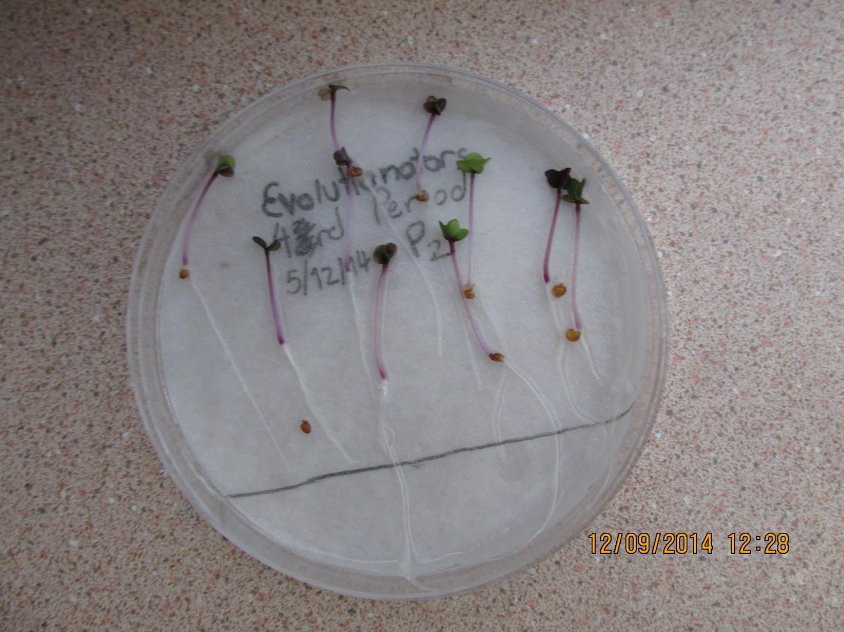
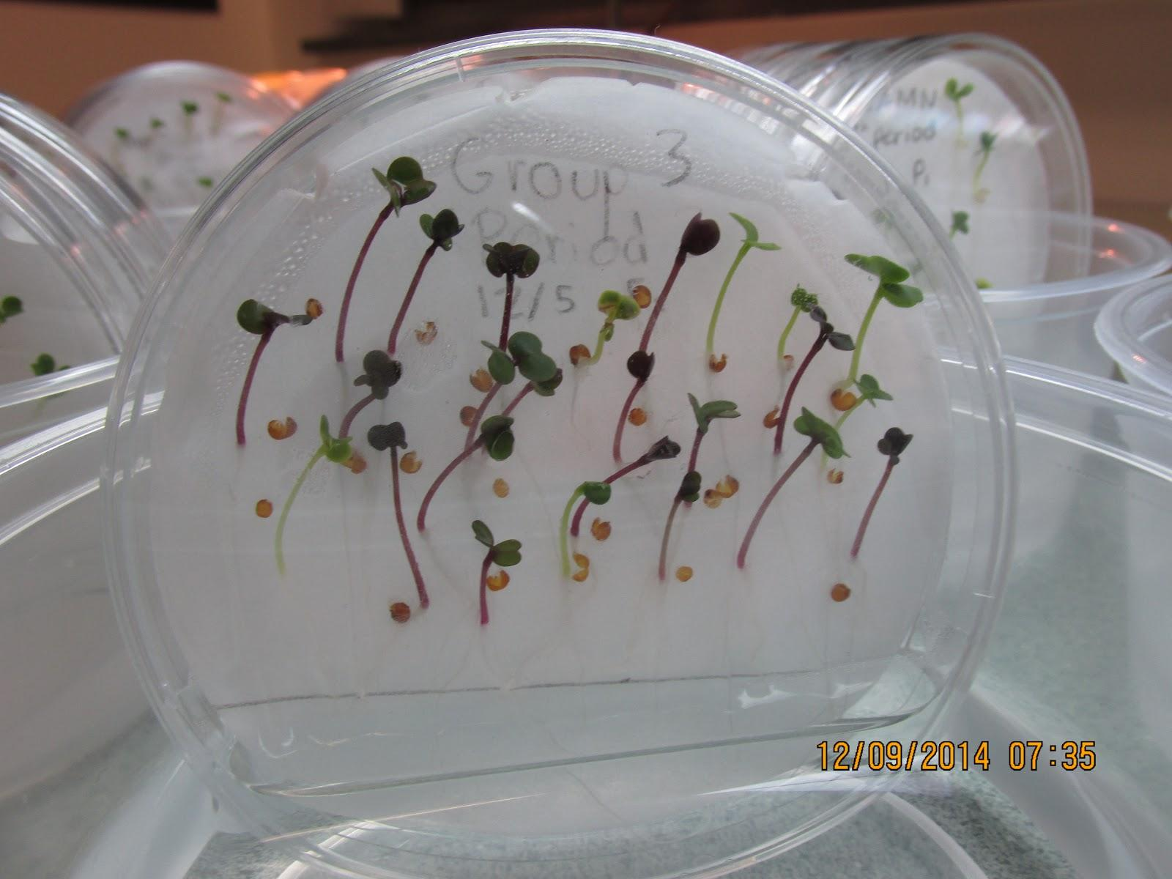
Fast Growing Plants Data 2014
Did your Punnett squares accurately predict the crosses?
P₁ | F₁
P₂ | F₂
Notes:
Data collected from our germinated seed lab.

Slide 23
Punnett Square Practice
If the blue eye allele is recessive (b) and the brown eye color is dominant (B), what would the outcome be for a parent, P₁ with alleles Bb that breeds with a parent, P₂ with alleles Bb. Set up a Punnett square for this cross and describe the offspring of this cross.

Slide 24
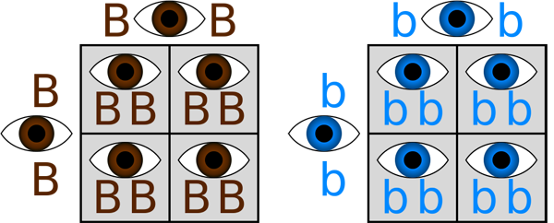
Punnett Square Practice

Slide 25
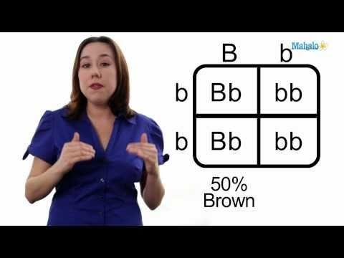
A Punnett Square is used to predict the outcome of a cross or breeding experiment.

Slide 26
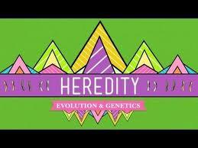
Review Heredity

Slide 27
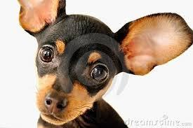
I want to hear from you:
What did you think about the lesson today?
What did you think about the online simulations?
What could I do differently?

Slide 28
Punnett Square
http://www.sumanasinc.com/webcontent/animations/content/mendel/mendel.swf
Threats to biodiversity
http://www.youtube.com/watch?feature=player_detailpage&v=prkHKjfUmMs

