Slide 1
Indicators of
Water Quality
Turbidity
Dissolved Oxygen
Temperature
pH
Nitrates
Bio-indicators

Slide 2
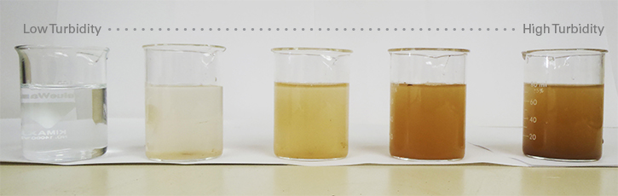
Turbidity Definition
Turbidity is the measure of the degree to which water looses its transparency due to the presence of suspended particulates.
http://oos.soest.hawaii.edu/pacioos/focus/modeling/roms_turb.php
Notes:
Instruct students to write definition in their Water Faucet Activity under Turbidity: What is Turbidity?

Slide 3
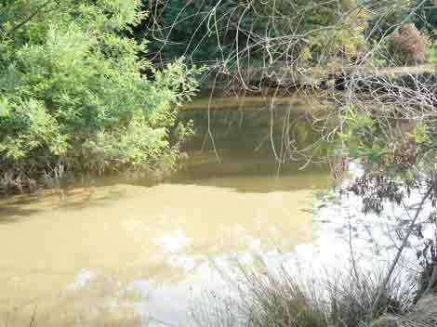
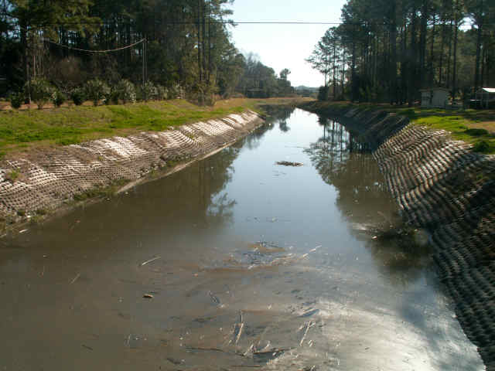
Turbidity Levels
Ideal Level: 1 NTU (Nephelometric Turbidity Units)
High Level: 5 NTU and above
http://www.seagrant.sunysb.edu/oli/Water%20Quality/Images/pollution4.jpg
Notes:
Instruct students to answer questions on ideal levels of turbidity in Water Faucet Activity.

Slide 4
Some causes of increased turbidity
Increased levels of phytoplankton
Sediment from erosion
Re-suspended sediments from the bottom (stirred by bottom dwellers)
Waste discharge
Algae growth
Urban runoff
Notes:
Turbidity is often caused by phytoplankton (single celled algae) or sediment in the water column. Submerged Aquatic Vegetative (SAV) needs light for photosynthesis, and fish need SAV for food, shelter, and oxygen. Natural forces like high winds, hurricanes, and rain storms stir up sediments on the bottom, increasing the cloudiness of the water. Man-made disturbances can include boat propellers, sediment from construction sites too close to the water, and dredging. Instruct students to answer question about causes of turbidity in Water Faucet Activity.

Slide 5
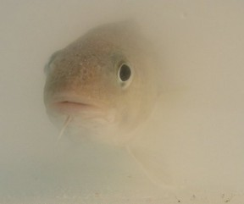
The results of high turbidity
High turbidity increases the absorption of sunlight thus making the water warmer.
Warmer water has lower levels of dissolved oxygen causing fish and larvae to die.
http://justin-meager.com/images/turbidcod2.jpg
Notes:
If suspended particles” block out” light, then these underwater life forms can’t thrive. Turbidity can prevent fish from finding food and from operating effectively within their environment. Turbidity can also clog the gills of fish and shellfish, killing them directly. Instruct students to answer question about the results of high turbidity in Water Faucet Activity. Allow time for students to answer question about the relationship between turbidity and water quality.

Slide 6
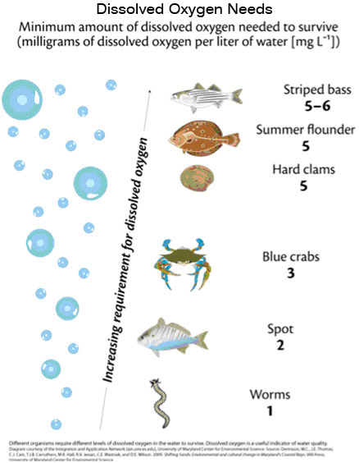
Dissolved Oxygen (DO)
Dissolved Oxygen: the amount of oxygen dissolved in water.
Dissolved Oxygen is measured in parts per million (ppm) or milligrams per liter (mg/l).
http://www.watershedcounts.org/data/dissolved-oxygen-needs.jpg
Notes:
Dissolved Oxygen is a critical factor for most aquatic organisms and is one of the most important indicators of environmental health. Instruct students to write definition of DO on their Water Faucet Activity Sheet.

Slide 7
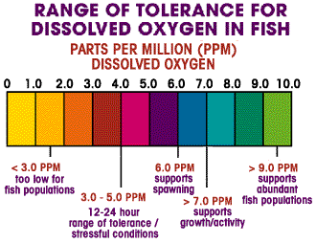
Dissolved Oxygen Levels:
Average Level: 9.0 ppm
Must be 4 – 5 ppm to support diverse population of fish.
http://www.sciencepartners.info/?page_id=461
Notes:
Oxygen is added to the water from the air through the churning action of the wind. Underwater plants (SAV) also supply oxygen to the water during photosynthesis. Instruct students to answer questions on average DO levels on Water Faucet Activity sheet.

Slide 8
Changes in DO levels can be caused by….
Turbulent actions waves (rapids)
Water depth
Plant growth
Salinity of water
  As salinity increases, DO potential in the water decreases.
Notes:
DO levels in an estuary vary seasonally, with the lowest levels usually occurring during the summer months. Cold water can hold more oxygen than warm water, so levels naturally increase during the fall and winter. Bacteria, fungi and other organisms affect DO levels in an estuary because they consume oxygen while breaking down organic matter (dead plants and animals). Instruct students to answer question on causes of changes of DO levels.

Slide 9
Dissolved Oxygen Results:
Results of changes in dissolved oxygen:
When DO drops too low fish die.
When DO is high, the water actually tastes better but can corrode water pipes.
Notes:
When oxygen levels in water fall below 4ppm, fish and other aquatic organisms become severely stressed; below 2pppm, many can’t survive. Instruct students to answer questions in Water Faucet Activity that address the results of changes in DO levels and the relationship between DO and water quality.

Slide 10
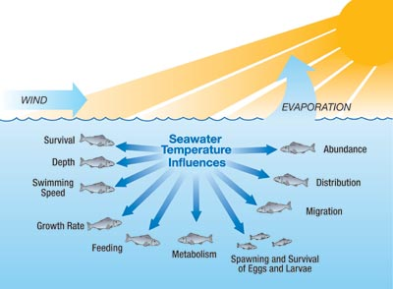
Temperature
Definition: Temperature is the measure of average kinetic energy.
Temperature is defined as the degree of hotness or coldness measured on a definite scale.
http://media.midcurrent.com.s3.amazonaws.com/wp-content/uploads/2011/03/ThermalOptimum_400.jpg
Notes:
Temperature is a critical factor when determining water quality. Many biological, physical, and chemical principles as well as feeding and reproduction of aquatic life are temperature dependent. The temperature of the water is also critical in determining where marine organisms live and how well they thrive there. Instruct students to write definition of temperature in their Water Faucet Activity sheet.

Slide 11
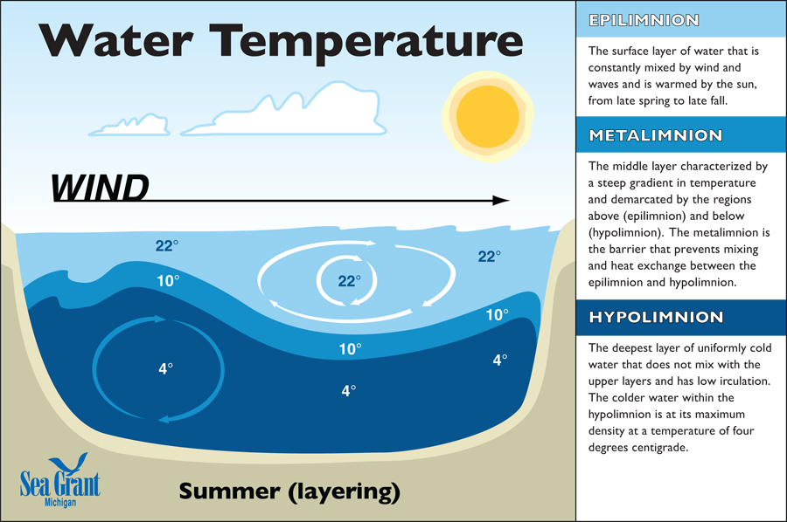
Temperature Levels:
Levels:
Low: cannot be tolerated below 32 degrees F
High: only rough fish can tolerate temperatures above 97 degrees F
http://www.miseagrant.umich.edu/lessons/files/2013/05/DZ_Lesson3_water-temp-graphic-web.jpg
Notes:
Some bodies of water have temperature that remain fairly constant, but that is not the case for rivers, sounds, and estuaries. Because they have a variety of depth and are affected by currents, the temperature varies greatly depending on a number of factors, especially the season. Instruct students to answer question on ideal levels of temperature on Water Faucet Activity sheet.

Slide 12
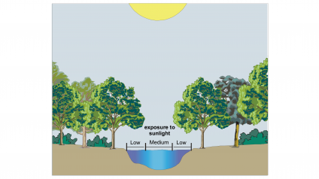
Some changes that cause a change in temperature…
Source of water
Time of year
Suspended sediment
Depth of water
Shade from shoreline vegetation
The benefit of a vegetative buffer.
http://www.vernier.com/experiments/esv/10/temperature/
Notes:
In the spring and summer in NC, the sun warms the surface waters and the deeper waters stay a bit cooler. The surface waters cool down in the fall, becoming more dense than the bottom waters. The density causes surface water to sink to the bottom, pushing the bottom waters closer to the surface. This “turn over’ or upwelling is very important to the health of a water system. This process provides a mechanism for the nutrients which have settle to the bottom to be stirred up and releases them into higher water levels. These nutrients are essential to the growth of all organisms. Instruct students to answer question about factors that cause changes in temperature.

Slide 13
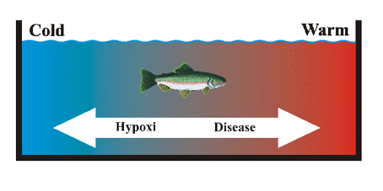
Results of changes in temperature…
Changes in temperature can make aquatic life susceptible to disease and at extreme levels can result in death.
http://esi.stanford.edu/temperature/imagestemperature/fishtemperaturepreference.jpg
Notes:
The temperature of the water is also critical in determining where marine organisms live and how well they thrive there. Instruct students to answer questions concerning results from changes in temperature and the relationship between temperature and water quality.

Slide 14
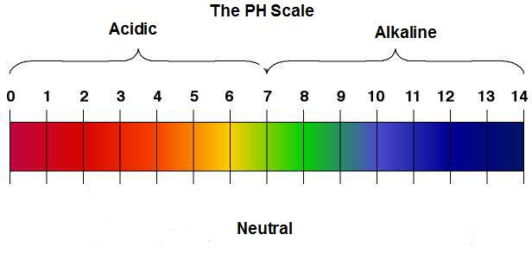
pH Definition:
pH: the acidity of the water (presence of hydrogen ion)
pH number between 0 and 7 is acidic
pH number at 7 is neutral
pH number between 7 and 14 is basic
http://www.abundanthealthcenter.com/blog/wp-content/uploads/2011/04/PH-Scale.jpg
Notes:
pH is a measurement of how acidic or basic something is. It is measured on a scale from 0-14. Acidic values are from 0-7, with 0 being the most acidic. Basic numbers are from 7-14. A neutral pH is 7 (an example of this would be distilled water). Instruct students to define pH on the Water Faucet Activity sheet.

Slide 15
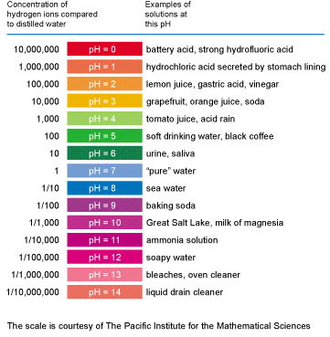
pH Scale
Notes:
The pH scale, like the Richter scale, is logarithmic. This means that each unit change (e.g., 5 to 6) is a tenfold change in the pH of the substance. Water with a pH of 5 is 10 times more acidic than water with a pH of 6. Instruct students to answer questions concerning acids and bases on the Water Faucet Activity sheet.

Slide 16
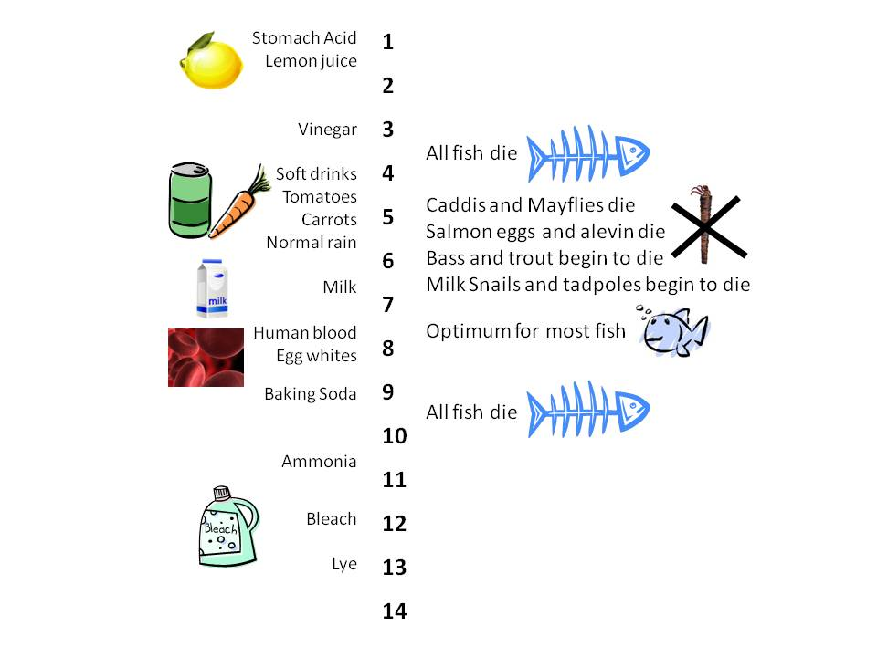
pH Scale Levels:
Surface Freshwater: between 6 and 9
Swamps: as low as 4.3
Salt Water: 8.1 but can be as low as 7.7
http://extension.usu.edu/waterquality/images/uploads/Whats%20in%20your%20water/pH%20table.jpg
Notes:
Instruct students to answer question on Water Faucet Activity sheet concerning pH levels.

Slide 17
Causes of the change in pH levels
Causes of changes in pH:
Natural conditions (especially in swamps)
Dumping of waste (batteries)
Farm runoff (lime)
Notes:
Water with an extremely high or low pH is deadly. Instruct students to answer question on what causes changes in pH.

Slide 18
Results of changes in pH levels
A change in pH by two units results in water system having 100 times a difference in acidity.
Most aquatic life cannot withstand water outside of the optimum pH thus resulting in death.
Notes:
Water with relatively low pH (acidic) may reduce the hatching success of fish eggs and irritate fish and aquatic macro-invertebrates (water bugs) gills and damage membranes. Amphibians are particularly vulnerable, probably because their skin is so sensitive to pollutants. Some scientists believe the recent drop in amphibian numbers around the world is due to low pH levels caused by acid rain. Instruct students to answer questions concerning results of a change in pH and the relationship between pH and water quality.

Slide 19
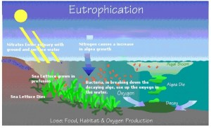
Nitrates
Nitrate (NO₃) is a naturally occurring form of nitrogen found in soil. Nitrogen is essential to all life.
Nitrates are compounds that contains the nitrogen based polyatomic ion NO3.
Nitrates is one form of dissolved nitrogen that occurs naturally in soil and water.
It is the primary source of nutrients for plants and may be used as fertilizer.
http://www.wheatleyriver.ca/wp-content/uploads/2011/02/Eutrphication-300x183.jpg
Notes:
The formation of nitrates is an integral part of the nitrogen cycle in our environment. Instruct students to define nitrates on their Water Faucet Activity sheet.

Slide 20
Nitrates Levels:
Drinking water max: 10 mg/L (Test yearly if you own your own well).
Fish: below 90 mg/L seems to have no effect on warm water fish.
Notes:
Most natural concentrations are not a health concern to humans, but when excess nitrates get into water this can pose a problem for human health. A nitrate level up to 3 parts per million (ppm) is generally considered naturally occurring and safe for drinking. The U.S. Environmental Protection Agency (USEPA) has set the primary drinking water standard for nitrates at 10 ppm. Concentrations that are significantly higher than the standard may be harmful to people and livestock. There is no standard for private well waters, nor is testing required, which means the private well owner is responsible for testing their own water. Instruct students to answer question on safe level of nitrates in drinking water.

Slide 21
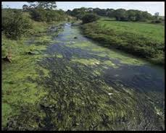
Nitrates
Excess of Nitrates in water can cause eutrophication.
Notes:
Eutrophication: natural process that ultimately turns a lake into dry land over time through an increase in sediment, nutrients and organisms.

Slide 22
Nitrates… some causes
Fertilizer runoff (both farm and home)
Manure pits
Leaks in septic systems
Animal waste
rain trapping car exhaust
Notes:
Most natural concentrations are not a health concern to humans, but when excess nitrates get into water this can pose a problem for human health. Some human activities that introduce nitrates into water are fertilizing, runoff from animal feedlots, leaky septic tanks, industrial wastes and wastewater treatment lagoons. Instruct students to answer question concerning causes of high levels of nitrates on Water Faucet Activity sheet.

Slide 23
Results of the presence of nitrates..
Nitrates can increase the plant production and fish population resulting in overcrowding.
If algae increases due to nitrates, the DO levels can decrease, killing fish.
Nitrates are converted to nitrites in humans (can kill children).
Notes:
Instruct students to answer question concerning the results of an excess of nitrates in water.

Slide 24
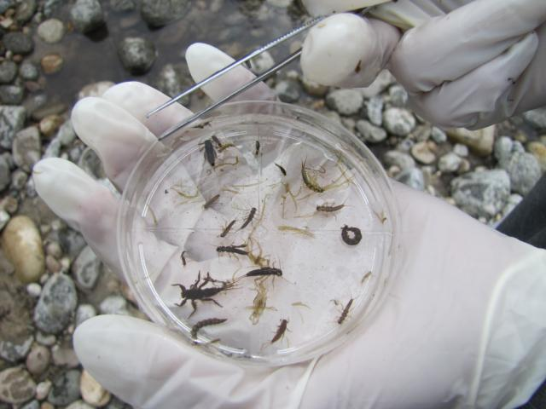
Bio-Indicators:
Definitions: Macro-invertebrates found living in water (they tend to remain in one place) that are sensitive to pollution.
These are organisms, chemical markers or biological processes whose change points to altered environmental conditions.
http://www1.nsd131.org/mainsite/schools/wms/PhotoGallery/8th%20Grade%20Science%20Trip%20to%20Payette%20River/_w/Collection%20of%20Macroinvertebrates_jpg.jpg
Notes:
Bio-indicators are indicators of water quality. Different types of macro-invertebrates tolerate different stream conditions and levels of pollution. Depending on the types of macro-invertebrates found in a stream, predictions about water quality can be made. Instruct students to define bio-indicators on their Water Faucet Activity sheet.

Slide 25
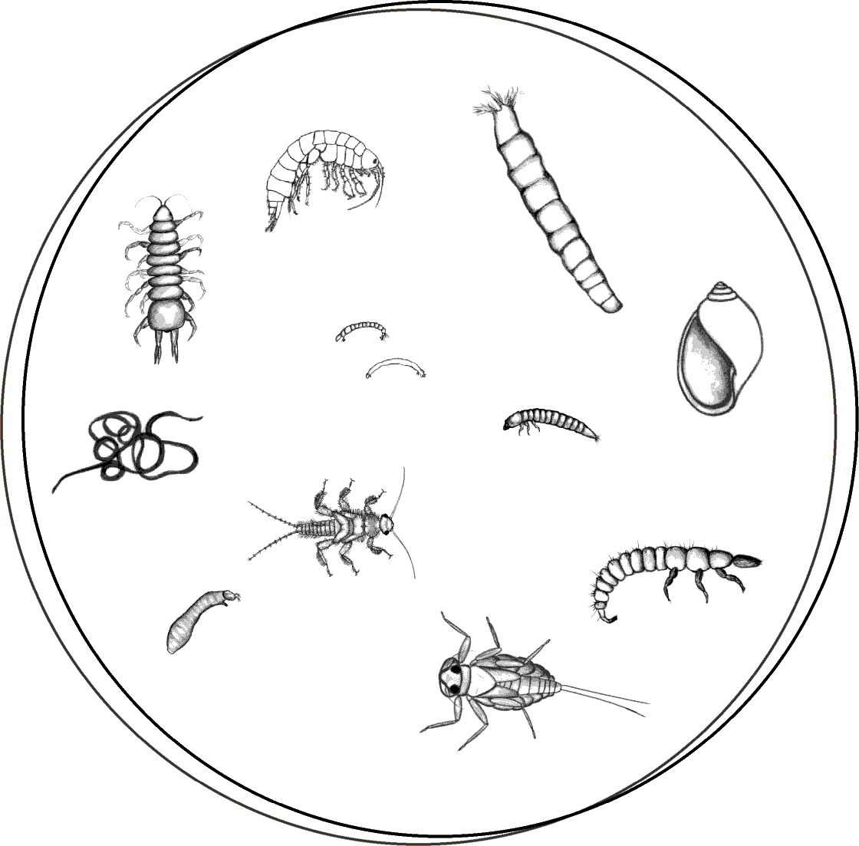
Bio-Indicators Levels
High level of variety: Good supply of healthy bi0-indicators will indicate a healthy water source.
Small level of variety: Poor water source (indicator of high levels of pollution)
http://www.seanet.com/~leska/Online/petri.gif
Notes:
What is an aquatic macro-invertebrate? Let's break down the term. "Aquatic" means water, "macro" means big (or big enough for us to see without using a microscope) and "invertebrate" means without a backbone. So an aquatic macro-invertebrate is a water bug that we can see with our naked eye. Many of these macro-invertebrates make their homes in rocks, leaves and sediment in stream beds. Some of these insects and non-insects spend their entire lives in water, like scuds, clams, mussels and snails. However, usually just the larva and nymph stages (the immature stages of insects' lives) are spent in water. Then the larva or nymph will spend it's adult life out of the water. Instruct students to answer questions concerning high and low level variety of bio-indicators.

Slide 26
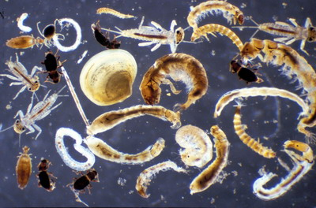
Bio-Indicators:
Causes of changes in bio-indicators:
Pollution that results in changes in pH
Temperature
Dissolved oxygen
Nitrate levels
http://telescript.denayer.wenk.be/~tgo/international/macroinvertebrates.jpg
Notes:
Instruct students to answer question of what causes changes in bio-indicators on their Water Faucet Activity sheet.

Slide 27
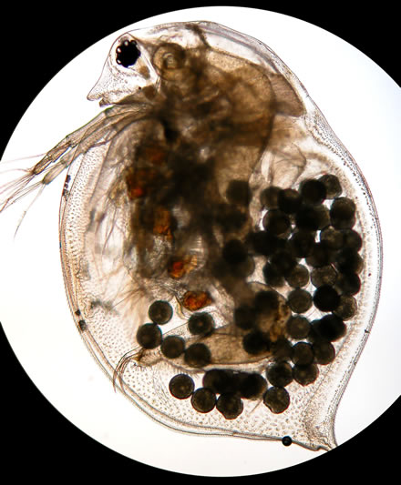
Bio-Indicators:
Results of few varieties of bio-indicators present:
The lack of a large number of different varieties of bio-indicators is indicative of pollution
Bio-Indicators are organisms used to keep the health of the environment in check.
A few bio-indicators are lichens, bacteria and daphnia.
http://www.umesc.usgs.gov/images/photos/microscopic/daphnia_eggs_sg04_440.jpg
Notes:
Caddis flies, mayflies, and stoneflies cannot live in polluted water. If these bugs are found in a stream, the water quality there is probably good. However, that doesn't mean that if these bugs are not found in a stream the water quality is bad. Other factors like temperature and flow also come into play. These bugs prefer cold rushing water, so a stream that has good water quality, but is a slow-moving stream in a desert may not have these bugs. Instruct students to write about the results of low levels of bio-indicators.

