Slide 1
Working with Data
Scientific Visualization Unit 5.00
Synthesize data for scientific & technical visualizations

Slide 2
Evaluate methods for displaying data using charts and graphs
Objective 5.01

Slide 3
Purpose
Charts and graphs are used to create a physical representation on the numbers in a dataset
Graphic representations of numerical data are:
Encourage quick comparison of different sets of data
Reveals several layers of detail that would be missed as raw data
Provides a clearer message than huge sets of numbers
Easier to remember

Slide 4
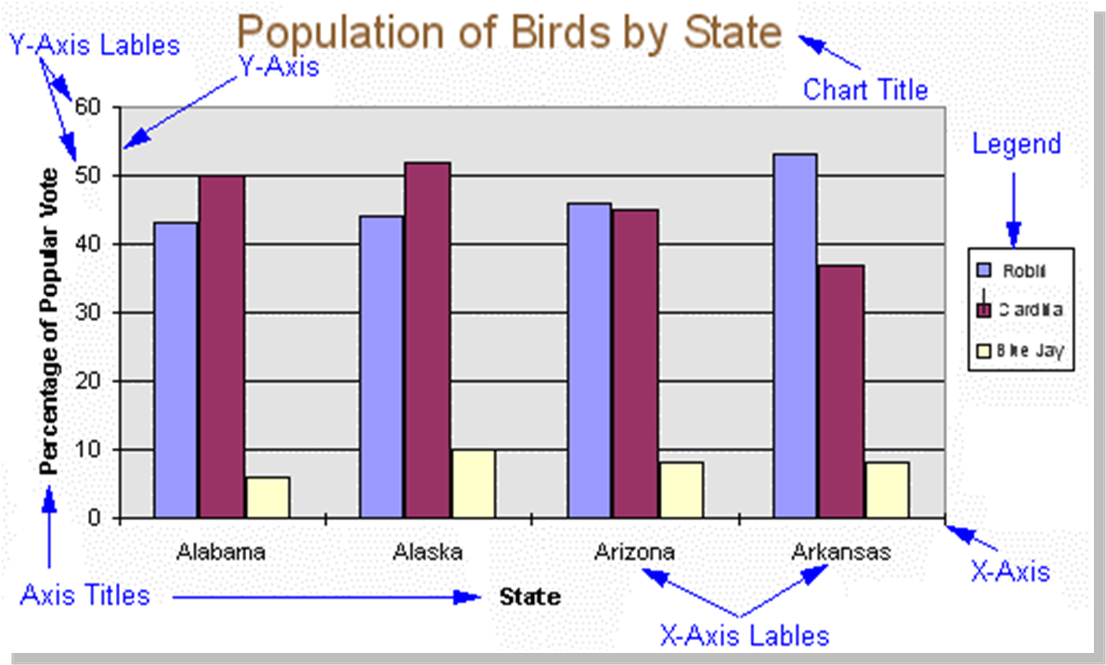
Common Chart Components
Title – Short overview of the information
Axis – Reference lines in a coordinate system
X-axis – horizontal
Y-axis – vertical
Label – Common data categories
Legend – List of symbols used in the chart
Data Value – Text showing actual value of an item
Callouts – Descriptive text in charts which is not data

Slide 5
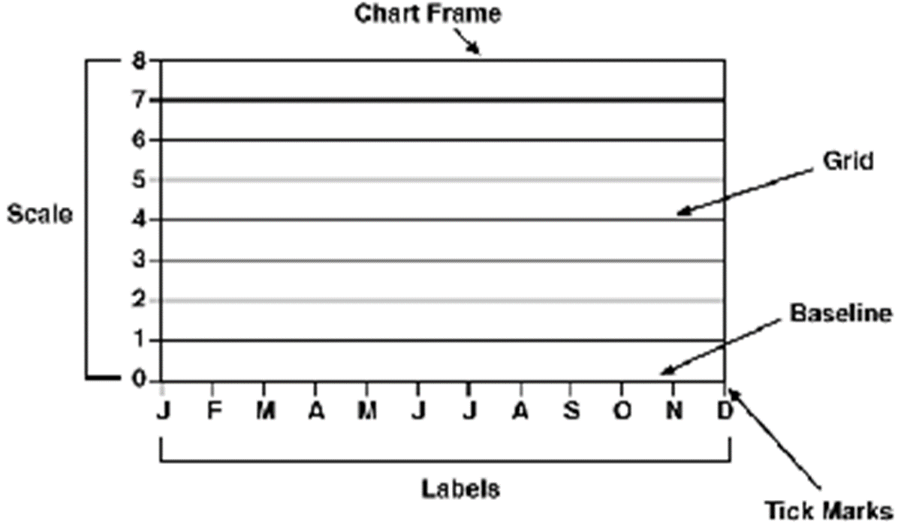
Common Chart Components
Frame
Defines the plot area boundaries
Grid
Scale guideline
Tick
Shorter line than grid to indicate a scale division
Scale
Evenly spaced increments for measuring the size or position of plotted data values

Slide 6
Selecting the Appropriate Chart
Different chart types are used depending on the question you are asking of the data
Three Main Chart Types:
Bar/Column – Used for comparing discrete, unrelated categories of data
Pie – Used for showing parts of a whole or percentages
Line – Used for comparing related variables and relationships over time

Slide 7
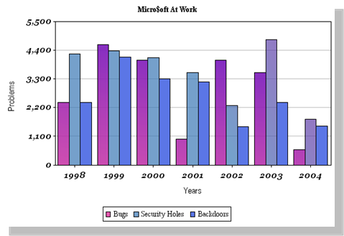
Bar/Column Charts
Variations:
Each bar/column represents a data element
Commonly consists of:
Linear scale along the vertical, Y-axis
Category scale along the horizontal, X-axis
Stacked Column:
Shows several sets of related data that add up to a whole in columns
Grouped Columns
Columns slightly overlap with the tallest column in the back of the set
Histogram
Displays frequencies or relative frequencies using columns that touch
Used to determine symmetrical distributions

Slide 8
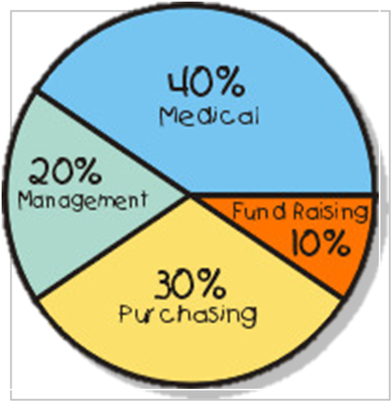
Pie Charts
Each segment is angled at the same percent as the data it represents
Data needs to be converted to percentages
Combined wedges always result in 100% when added together
Data may be contiguous or simultaneous in time
Variations:
Exploded Pie Chart
Used to highlight one slice for emphasis
3D Pie Chart
Used for aesthetic purposes
Often makes the data difficult to read

Slide 9
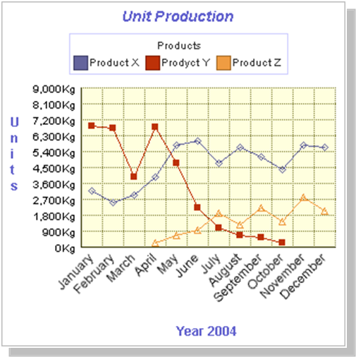
Line Charts
Variations:
Each line represents the changes in a variable over a distinct time/temperature range
Provides a clean, accurate picture of growth
Step Line Chart
Plots abrupt changes rather than gradual using plateaus of time values
Area Chart
Shades in the area between the X-axis and line
Scatterplot
Representation between two variables where the data points are not connected
Uses a line of best fit (average) to show relationships/trends

Slide 10
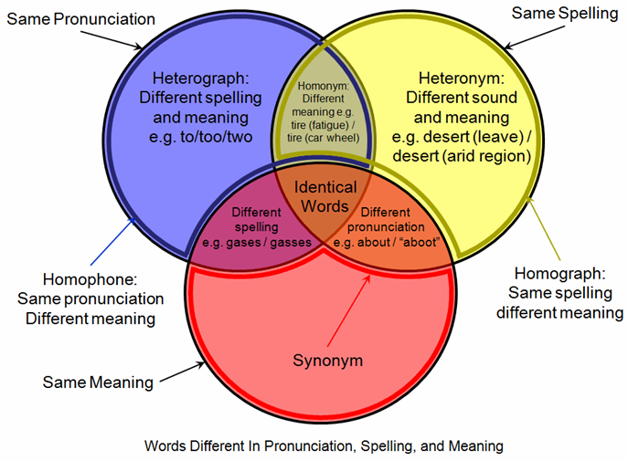
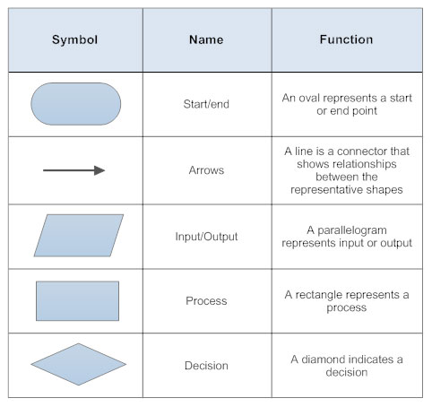
Other Ways to Represent Data
Not all data can or should be represented using a chart
Other common data visualizations include:
Venn Diagram – Used to show relationships between sets of data (similarities vs. differences)
Flowchart – Visual representation of a process used to solve problems using specific set of symbols to represent
Infographic – Combination of text, graphics and data to create a visually impactful message
Symbol Chart: http://wc1.smartdraw.com/flowchart/img/basic-symbols.jpg

Slide 11
Describe the steps of a design brief
Objective 5.02

Slide 12
Purpose of Design Briefs
Design briefs are documents used to plan out a project
Different industries and companies have different requirements for their design briefs but they all have four components in common:
Identify the main problem to solve
Describe a plan for solving that problem
Give a timeframe for when the project will be completed
Report on the results after completing the project
Common Examples:
Science – Research Proposal or Research Plan
Business – Business Plan
Game Design – Game Design Document (GDD)

Slide 13
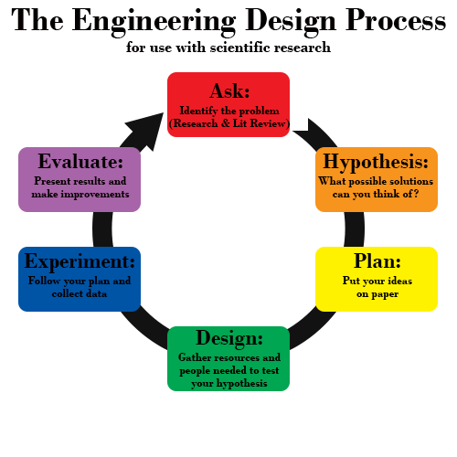
Using the Engineering Design Process
Ask Questions
Identify the problem that needs to be solved
Conduct a literature review
Form a Hypothesis
Determine a solution to the question
Plan & Design
Put your ideas on paper, gather necessary resources to test your hypothesis
Experiment & Collect Data
Conduct your experiment
Evaluate Your Results
Analyze the data
Determine how you will present your results to others: written report, slideshow presentation, etc.
Engineering Design Process:
Robert Bourgeois, Durham School of the Arts

Slide 14
Selecting a Topic
Brainstorming
Nominal Group Technique
Many projects begin by brainstorming during their asking phase
Brainstorming is:
A process that identifies as many possible answers to the problem being examined
All ideas are valuable – If this session is a group effort, these ideas are not criticized or discussed until the session is finished
Typically has a moderator to make sure everyone’s ideas are heard and the process is orderly
While there are many ways to determine which idea to pursue, one popular way involves nominal group technique
A way of organize information to show relative importance based on ranking by individuals on the team
Typically, each item is assigned a numerical value based on individual ranks
These are used to reduce the number of items in the list based on a top set of values (i.e. – keep top 5)
The process is repeated until there is a single idea remaining

Slide 15
Storyboarding: Visual Planning
Some industries use storyboarding as part of the planning process
Animation
Film
Game Design
Storyboarding is:
A series of quick sketches in sequence that illustrate the main ideas of the project
Generally not high detailed or quality drawings
Should include text, audio and video techniques, and direction for things like camera angles or specific actions necessary for a scene

Slide 16
Form a Hypothesis
An educated guess about how things work
Often written like this: "If _____[I do this] _____, then _____[this]_____ will happen."
Should be something that you can actually test
The main idea of your hypothesis is to state the relationship between the dependent and independent variables
The most powerful results come from controlled experiments where units being measured are grouped to keep unwanted errors from affecting results

Slide 17
Experimental Variables
Independent Variables
Dependent Variables
What you believe might influence the outcome measure
Manipulated by the research team
Ex. – Light colors
Plotted on X-axis
Modified based on independent variable
Prediction being made
Ex. – Growth of plants
Plotted on Y-axis

Slide 18
Different Design Types
Data Driven Design
Concept Driven Design
Collects data as numerical values that can be compared with each other
Examples – graphs, charts and tables
Used to explain a concept, idea or theory
Examples – how a car works, the water cycle, how to draw a tree

Slide 19
Conduct Experiment
Gather all the resources needed to conduct your experiment based on your design
Equipment
Dependent and independent variable sources
Special Personnel
Follow your research plan and collect data

Slide 20
Reporting on Results
Written Report
Multimedia Slideshow
Different industries/companies have different requirements
Science: Research Report
Often uses American Psychological Association (APA) writing conventions
Each section distinct and fully described
Game Design: GDD
States the core idea of the game
Identifies several concrete ideas that are critical to the game
Determine the target audience
Make sure the wording/material is appropriate
Use a template for consistency
Edit Master Slide to meet your needs
Edit the contents including graphics, videos, charts, etc.
General Rule - try to stick to short statements
7 lines of text, 7 words per line

Slide 21
Methods for Creating Presentations
IDEAL Method
SAFE Method
I:
Identify the problem
D:
Define a plan of work
E:
Explore the problem through research
A:
Act on the problem’s solution
L:
Look back at the process
S: Simple
If you keep the presentation simple, it will save you time, money, confusion and presentation problems
A: Appropriate
Make sure the content is appropriate for the audience
F: Functional
If a visual confuses an audience more than it helps to understand the topic, then it is not performing its function
E: Economical
Concentrate on the important items in your presentation so it only contains the elements needed to convey your message in a short period of time

Slide 22
Interpret data for use in charts and graphs
Objective 5.03

Slide 23
Data Collection
Empirically Derived
Computationally Derived
Physically measured
Examples – Using a ruler to measure length, height, width
This kind of data does not require any math to collect
Requires use of a mathematical formula to determine result
Examples – Calculate the area/volume/circumference

Slide 24
Measuring Data
Scalar Measurements
Vector Measurements
Data explaining the magnitude of the variable being measured
Lacks measurement of direction
Common scalar measurements:
Time (years, months, days, hours, etc.)
Volume (milliliters, liters, etc.)
Weight (ounces, grams, etc.)
Speed
Temperature
Data that contains both magnitude and direction of the variable being measured
Described using mathematical formulas
Common vector measurements
Increases/decreases in temperature
Velocity (rate an object changes position)
Directional measurements applied to scalar quantities

Slide 25
Basic Data Types
Parametric
Non-parametric
Used for predictable distributions
Interval
Measurements where the distance between values is the same
Example – Changes in temperature
Ratio
Values compared as multiples of one another
Value of 0 has meaning!
Example – Comparing height of people at different ages
Does not assume any predictable distribution
Nominal
Categorical where order is arbitrary
Example – Ethnicity
Ordinal
Categorized into logical order
Example – Likert Scales

Slide 26
Quantitative vs. Qualitative Data
Quantitative
Qualitative
Deals with numbers
Quantities
Can be measured
Length, height, weight, temperature, distance, etc.
Deals with descriptions
Quality
Can be observed but not measured
Color, texture, smell, interviews, etc.

Slide 27
Common Quantitative Calculations
11
12
12
12
13
15
17
18
25
26
52
12
12
12
Mean – Arithmetic Average
To calculate – Add all the given values and divide by the total number of values
Median – Middle
Defined as the middle value of several readings where all values are placed in an increasing or decreasing order
Mode – Most Common
Defined as the most commonly occurring value found in a group of consistent readings
15
213
/ 11
19.36

Slide 28

Identify Quantitative vs. Qualitative Data in the Image Below

Slide 29
Quantitative vs. Qualitative Data
Quantitative
Qualitative
Image or frame size
Measured as width x height in inches or centimeters
Weight
Measured in ounces, pounds or grams
Value
Measured in Dollars or Euros
Number of people, buildings, plants
Shades of colors used
How the picture smells
Texture of the brush strokes
Feeling given by the view presented
Stroke quality
Master or amateur?

Slide 30
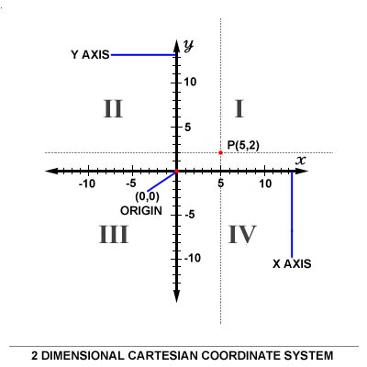
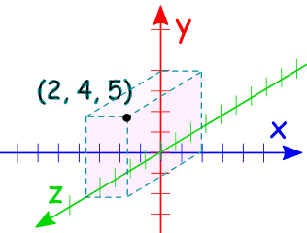
Working with Cartesian Coordinate Systems
A way of working with and defining positions in space
Maps, computer monitors, televisions and 3D modeling all operate using Cartesian coordinates
Plotting data points in 2D
X and Y coordinates
X – Horizontal
Y – Vertical
Each quadrant identified numerically
Positive values move up and right
Negative values move down and left
Plotting data in 3D
Adds Z coordinate
Provides depth
Origin is typically (0, 0, 0)

Slide 31
Regression Line
A line drawn through a graph of 2 variables
The line is chosen so it comes as close as possible to the majority of the data points without specifically connecting points
Used to show trends in data
The closer the points are to the line, the stronger the relationship
Direct or Positive Relationship
Points move from the lower left to upper right
An increase in X is more likely associated with an increase in Y
Indirect or Negative Relationship
Points move from upper left to lower right
And increase in X is more likely associated with a decrease in Y

Slide 32
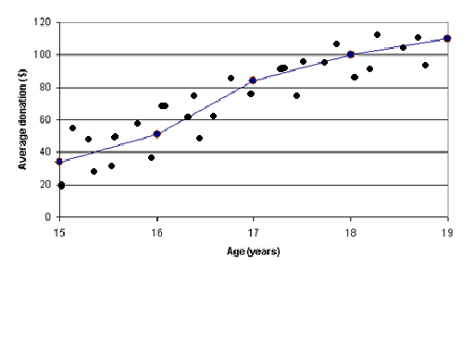
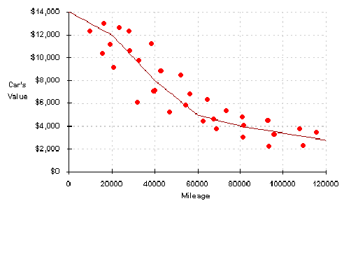
Data Relationships
Direct/Positive Relationship
Indirect/Negative Relationship

Slide 33
Apply data to make an appropriate graph
Objective 5.04

Slide 34
Getting Started
Are you creating the chart manually?
Gather necessary resources: paper, pencil, ruler
Are you creating the chart digitally?
Determine spreadsheet application you will use
Enter the data into the spreadsheet
Next, determine the appropriate type of chart to use
Bar/Column – Comparisons
Pie – Percentages
Line – Trends over time
Use the spreadsheets chart wizard to create your chart
Edit the information as needed (enter title, labels, scale, etc.)

Slide 35
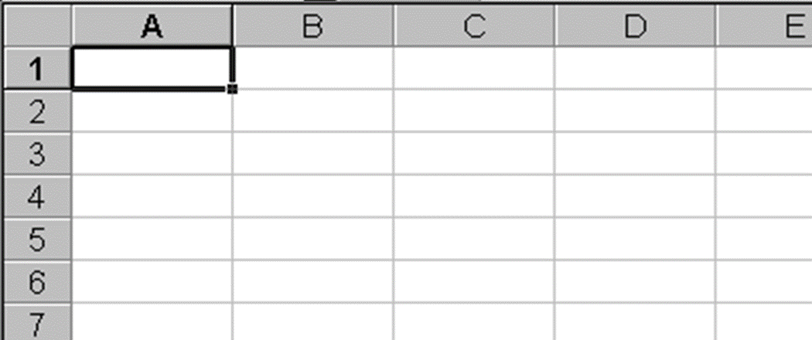
Entering Data in a Spreadsheet
Spreadsheets are made up of cells:
Columns are identified by letters
Rows are identified by numbers
Combined, they form a cell reference – A1
Label
Alphanumeric text or numbers not used in calculations
Values
Numbers used for calculations
Formulas
Statement used to perform a calculation - =A1+B1
Function
Formulas that are built into the program for common calculations

Slide 36
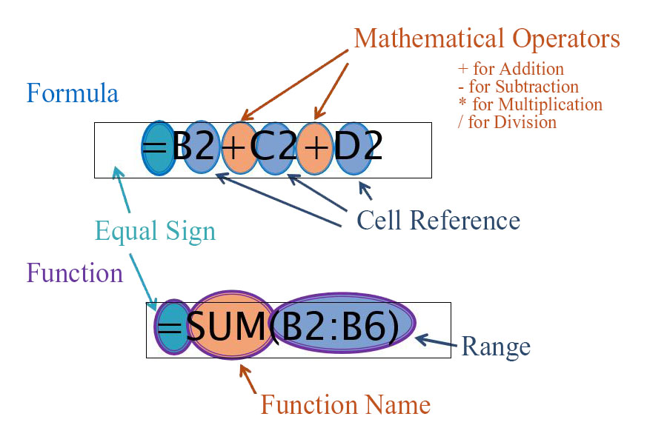
Manipulating Data
Order of Operations
Common Functions
PEMDAS
Parenthesis
Exponents
Multiplication
Division
Addition
Subtraction
SUM
Adds a range of values
Average
Calculates the range’s mean
Min
Finds the smallest value in a range
Max
Finds the largest value in a range
If
Performs a logical test

Slide 37
Steps to Making Charts Using a Spreadsheet
Once the data is entered, determine what kind of chart is needed to answer the question you are asking
Bar/Column – Compare datasets
Pie – Percentages or parts of a whole
Line – Changes over time or temperature
Select the data you want to create a chart about
Make sure if you need to perform any calculations, you have already done so before making a chart
Use your application’s chart wizard
The wizard will do most of the work for you based on your selections
However, some alterations may be needed and you might need to spend some time getting accustomed to the application you intend to use before making any charts

Slide 38
Rules for Creating Charts
One slide – One message – One chart
Each chart should have a single, well defined message based on the data and question asked of it
Keep graphs simple – Let the data do the talking
Avoid 3D, extra colors, and pictures
Use graphing paper or a spreadsheet application
Determine the correct chart type based on the question being asked of the data
Use the largest values to determine each axis scale and fill most of the chart area with your visualization
Each graphed item represents:
Category – name of measurable item and identified with a label
Data Point – Quantity associated
Plot the independent/control variable on the x-axis
Plot the dependent variable on the y-axis
Label each axis and provide regular numerical scale values
Most charts start at an origin of (0,0)
Provide a descriptive title
Use a legend to clarify datasets (especially for line graphs)

